Slide 1
WELCOME ALL
SHABANA

Slide 2
Geometry

Slide 3
TOPICS
Lines, Angles, Triangles,
TRIGNOMETRY
CO ORDINATE GEOMETRY
MENSURATIONS
Quadrilaterals, Polygons, Circles

Slide 4
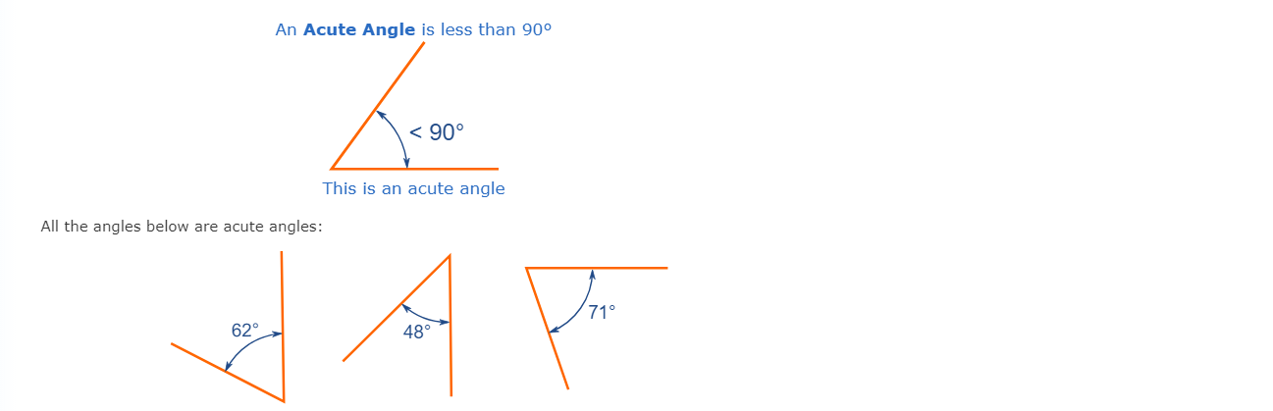
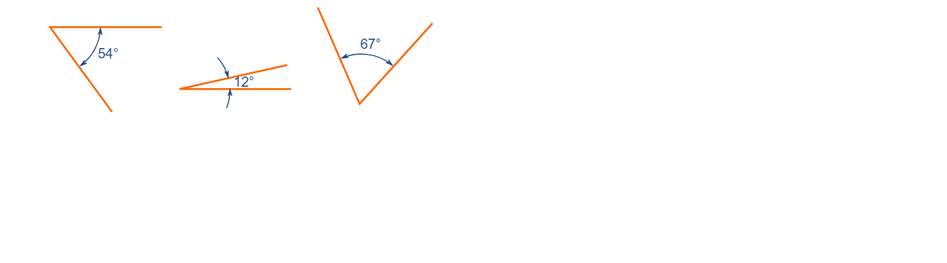
ANGLES
Acute Angle

Slide 5
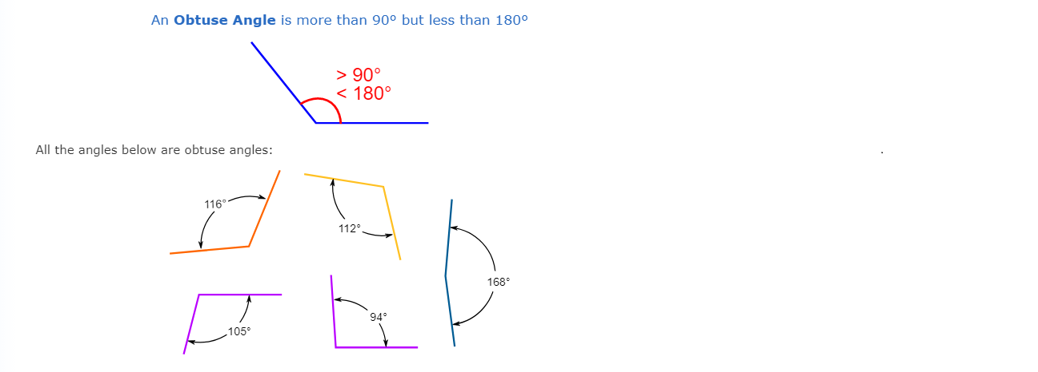
ANGLES
Obtuse Angle

Slide 6
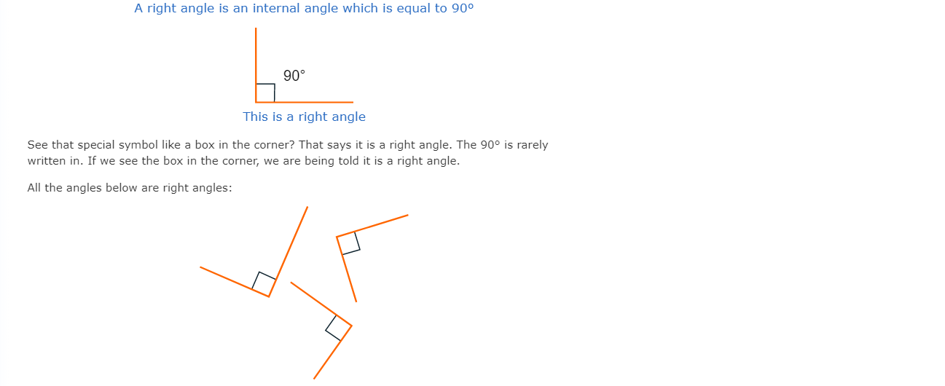
ANGLES
Right Angle

Slide 7
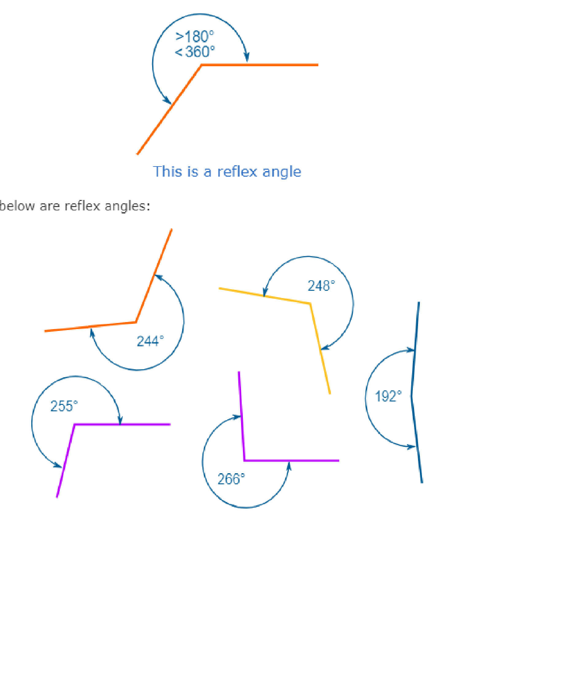
ANGLES
Reflex Angle
A Reflex Angle is more than 180° but less than 360°

Slide 8
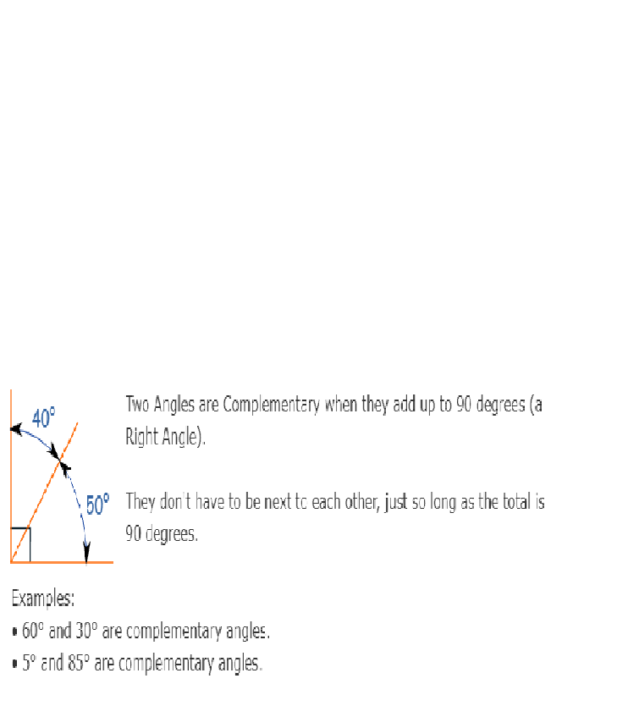
ANGLES
Complementary Angles

Slide 9
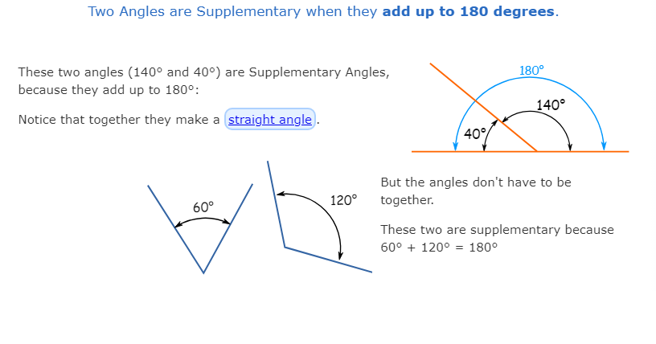
ANGLES
Supplementary Angles

Slide 10
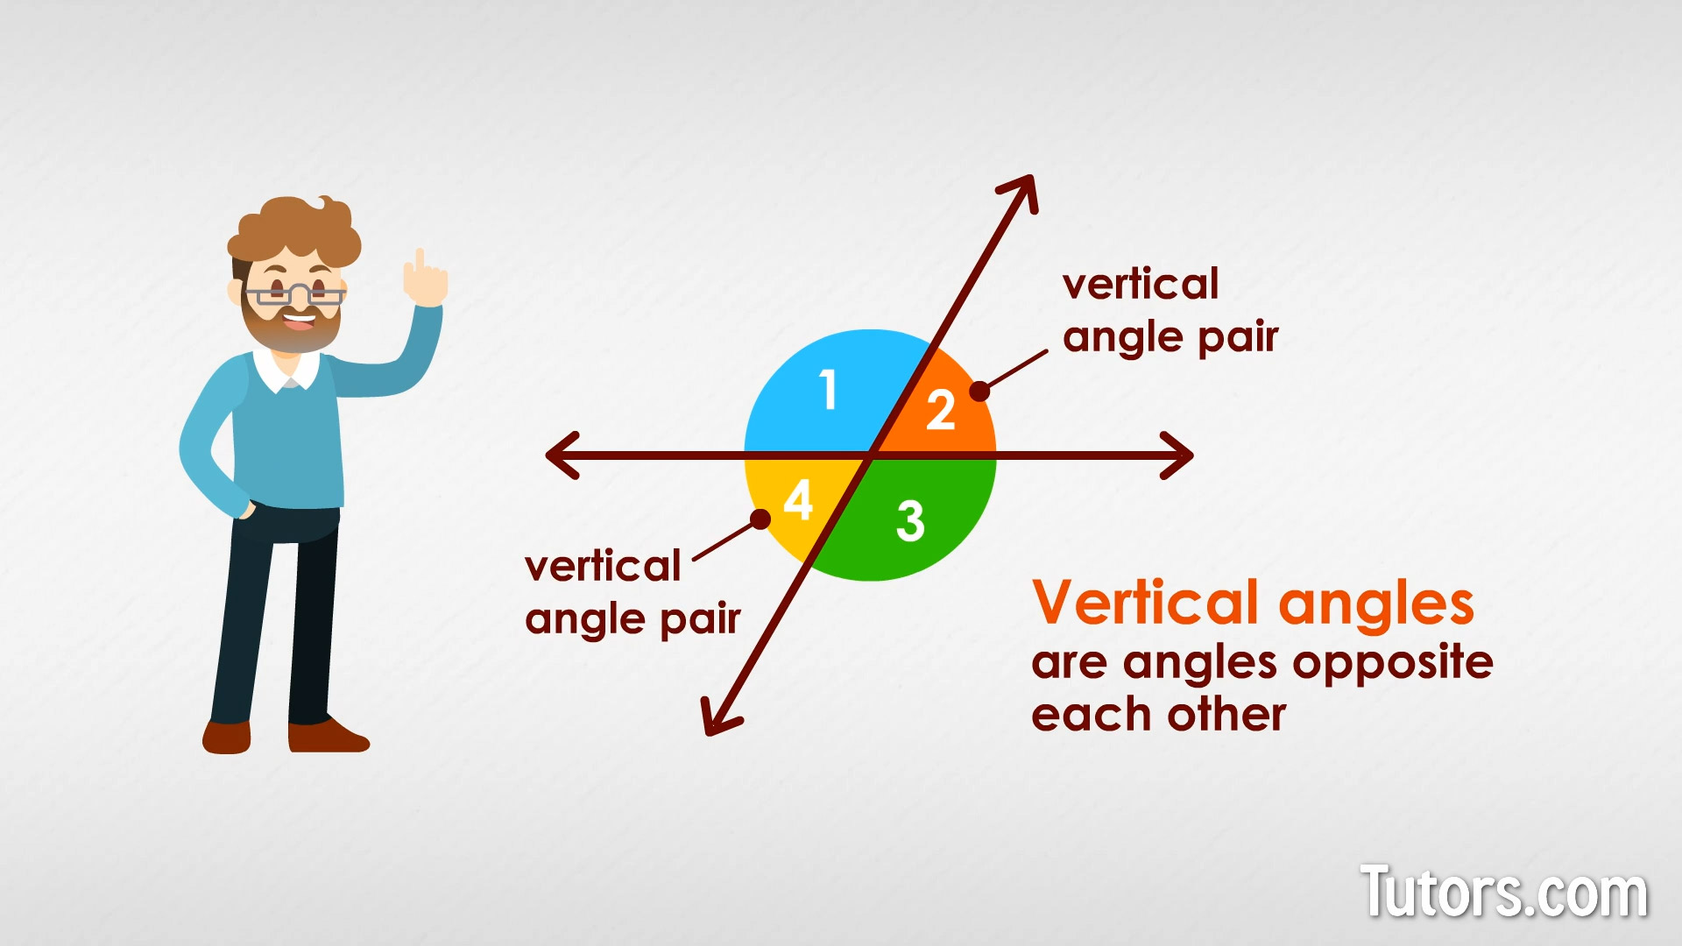
ANGLES
Vertical angles
When 2 lines or line segments intersect, two pairs of congruent equal angles are formed. The congruent angles formed by the intersection of lines are called Vertical angles.

Slide 11
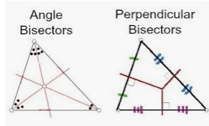
ANGLE BISECTOR & PERPENDICULAR BISECTOR
An angle bisector divides an angle into two congruent angles.
A perpendicular bisector splits a segment into two congruent segments and is perpendicular to that segment.

Slide 12
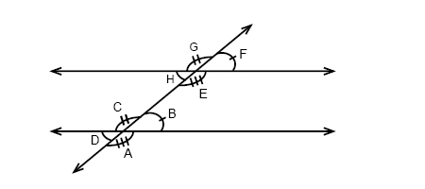
PARALLEL LINES
When a straight line cuts 2 or more parallel lines, the line is said to be transversal.
Alternate exterior angles – G & A and F & D (Congruent)
Alternate interior angles – H & B and C & E (Congruent)
Corresponding angles – G & C, F & B, H & D and E & A. (Congruent)

Slide 13
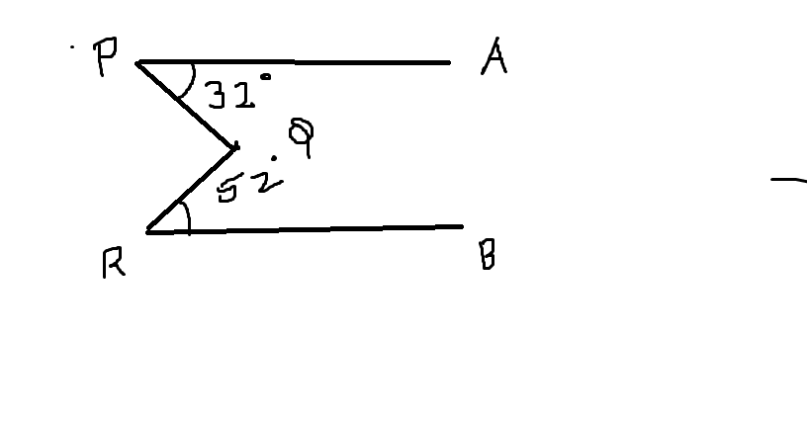
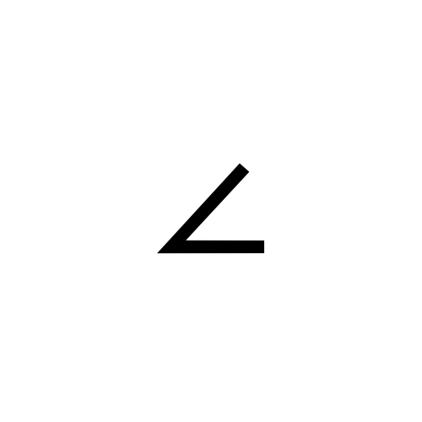
PROBLEM - 1
In the given figure, PA is parallel to RB, Find PQR
90
76
84
80

Slide 14
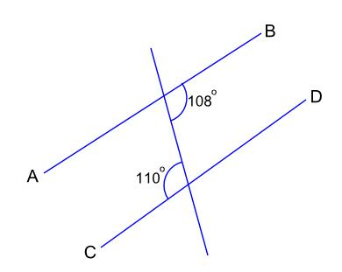
PROBLEM - 2
The straight lines AB and CD are
Parallel
Not parallel because the two given consecutive interior angles do not add to 180
Not parallel because the two given corresponding angles are not equal
Not parallel because the two given alternate angles are not equal

Slide 15
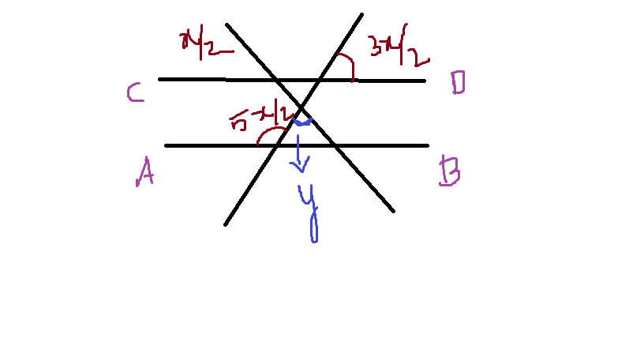
PROBLEM - 3
30
45
60
90

Slide 16
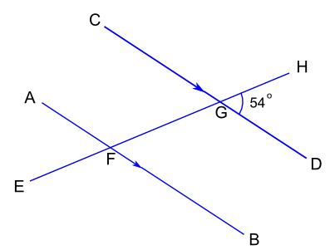
PROBLEM - 4
AB and CD are parallel lines and EH is a transversal. What is the size of angle EFB?
54
126
136
144

Slide 17
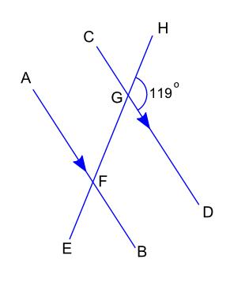
PROBLEM - 5
AB and CD are parallel lines and EH is a transversal. What is the size of angle AFG?
51
59
61
119

Slide 18
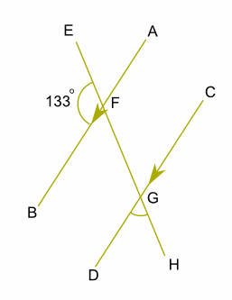
PROBLEM - 6
AB and CD are parallel lines and EH is a transversal. What is the size of angle DGH?
a. 47 b. 57 123 d. 133

Slide 19
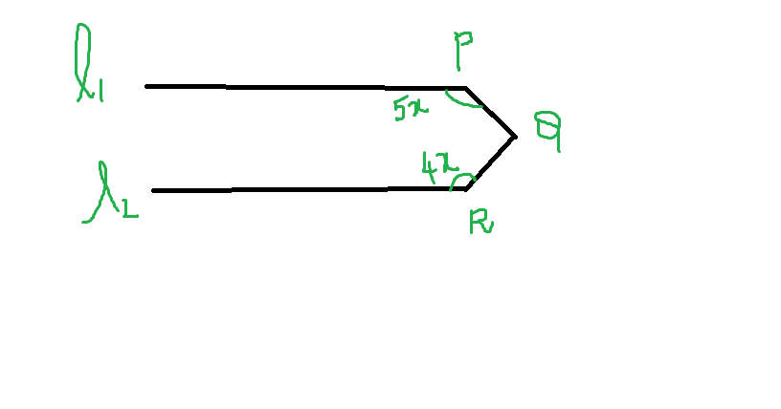
PROBLEM – 7
In the figure L1 and L2 are parallel lines and measure of angle PQR = 90. What is x?
a. 90 b. 20
c. 30 d. 40

Slide 20
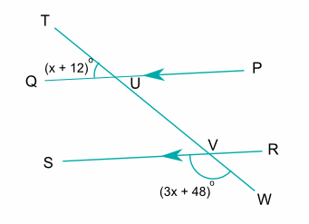
PROBLEM - 8
PQ and RS are parallel lines and TW is a transversal. The size of angle TUQ is (x + 12)° and the size of angle SVW is (3x + 48)° What is the value of x?
18
20
30
42

Slide 21
TRIANGLES

Slide 22
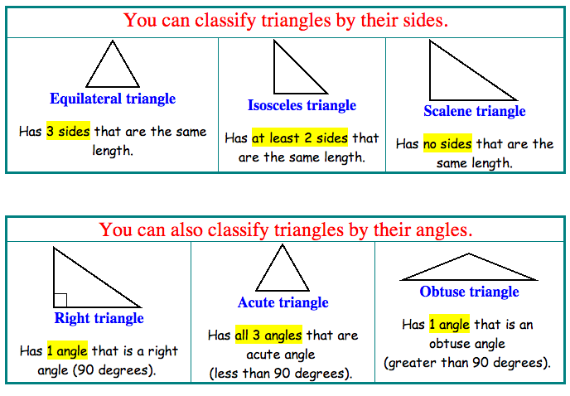
CLASSIFICATION

Slide 23
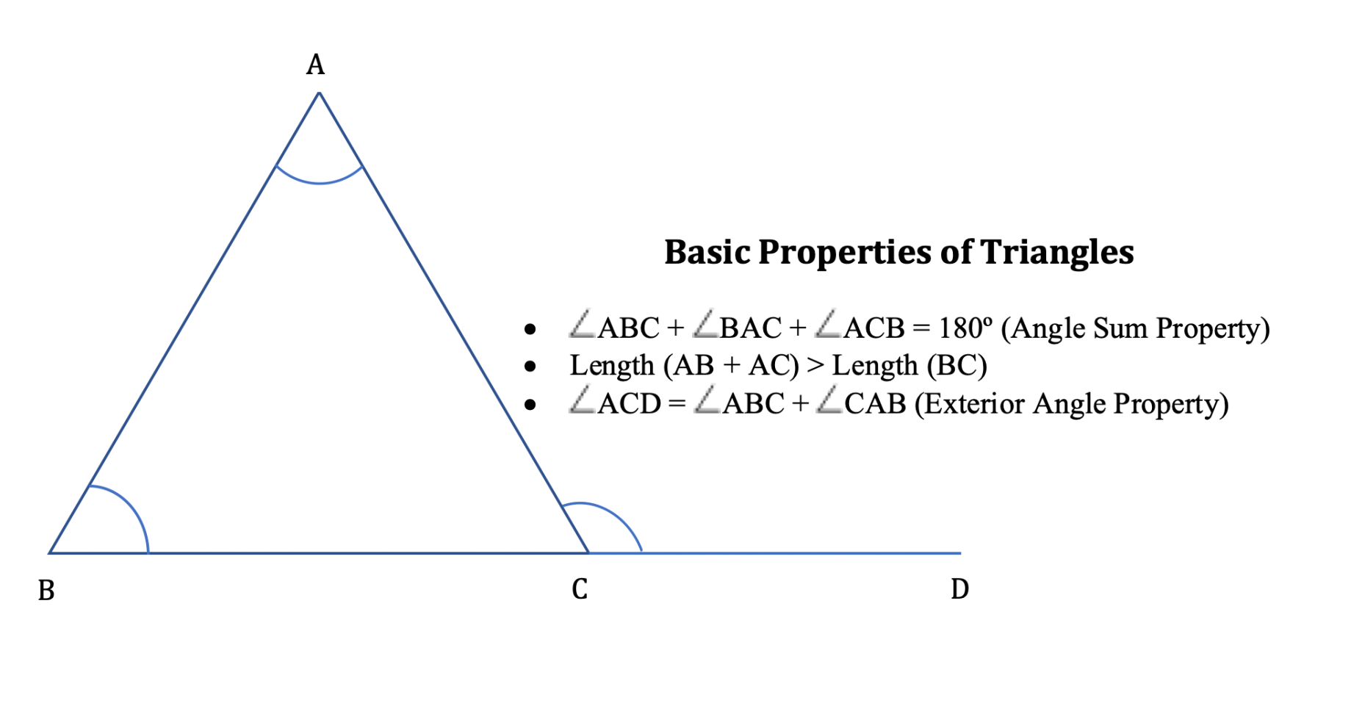
PROPERTIES
The side opposite to the largest angle will be the lengthiest side.

Slide 24
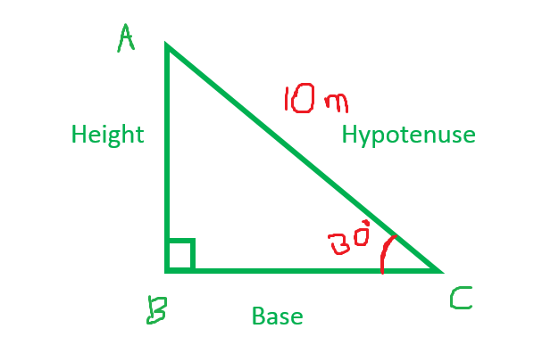
RIGHT ANGLED TRIANGLE
Find AB and BC...???

Slide 25
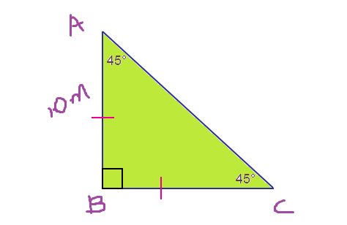
RIGHT ANGLED ISOSCELES TRIANGLE
Find AC & BC..???

Slide 26
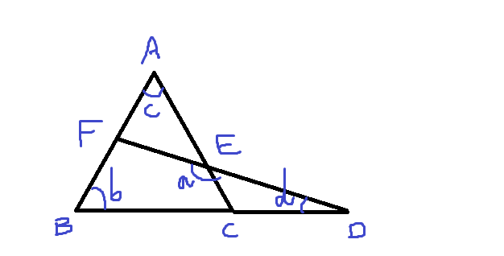
PROBLEM - 14
a = 125; b = 45
Find c+d..???

Slide 27
PROBLEM - 15
The two sides of a triangle are 12 cm and
7cm. If the third side is an integer, find the
sum of all the values of the third side.

Slide 28
PROBLEM - 16
In a triangle the measure of all the angles (in
degrees) are integers. One of the angles of
the triangle is 50. How many combinations of
the angles of the triangle are possible if it is
acute angle triangle.?

Slide 29
PROBLEM - 17
In an isosceles triangle ABC, the external
angle at C measures 130. What will be the
maximum number of possibilities of
measures of the angles of triangle ABC.

Slide 30
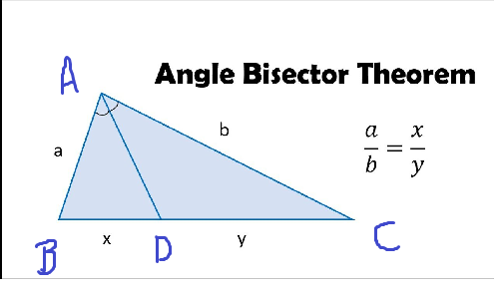
ANGULAR BISECTOR THEOREM
In triangle ABC, AD is the angular bisector, then
AB / AC = BD / DC

Slide 31
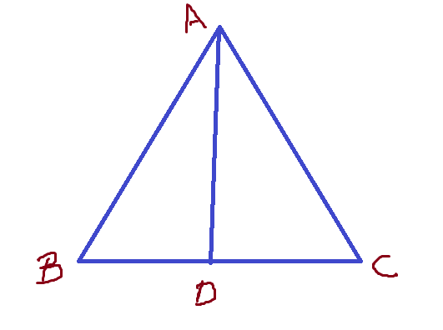
APOLLONIUS THEOREM
ABC is a triangle, AD is median;
BD = DC
According to Apollonius theorem,
2 (AD² + BD²) = AB² + AC²

Slide 32
TERMS & EXPLANATIONS
PERPENDICULAR
BISECTOR
ANGLE BISECTOR
ALTITUDE
MEDIAN
CIRCUMCENTER
INCENTRE
ORTHOCENTRE
CENTROID

Slide 33
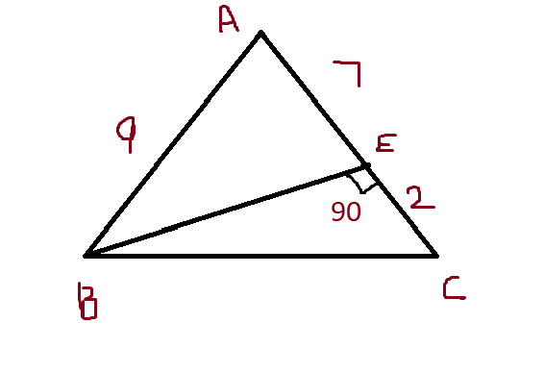
PROBLEM - 18
In the adjoining figure of an isosceles triangle, find the value of x

Slide 34
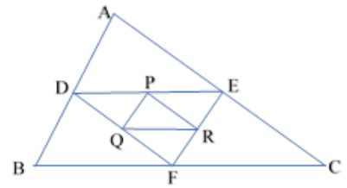
PROBLEM - 19
In the given figure D, E and F are mid points of AB, AC and BC respectively. P, Q and R are mid points of DE, DF and EF. Find ratio of area of triangle PQR to that of parallelogram ADFE.
NOTE : Three straight lines which join the middle points of the sides of any triangle, divide it into four equal (or congruent) triangles

Slide 35
PROBLEM - 20
ABC is an isosceles triangle right angled at B. Similar triangles ACD & ABE constructed on sides AC & AB respectively. Then the ratio between the areas of triangle ABE & triangle ACD is

Slide 36
PROBLEM - 21
If ABC and DEF are similar triangles and BC = 4
cm, EF = 7 cm, area of ABC is 144 cm2 then find
the are of DEF
252 cm² b. 504 cm² c. 441 cm²
d. 324 cm² e. 325 cm²

Slide 37
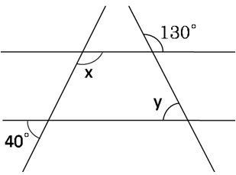
PROBLEM - 22
What is the average of angles x and y?
a. 80° b. 90° c. 95° d. 85°

Slide 38
PROBLEM - 23
Triangle ABC is similar to triangle PQR and their
areas are in ratio 1:4 respectively. If PQ = 6, QR = 8
and PR = 10, find the length of AB
a. 2 b. 3 c. 4 d. 5 e. 6

Slide 39
PROBLEM - 24
In a triangle ABC, the lengths of the sides AB, AC and
BC are 3, 5 and 6 cm respectively. If a point D on BC
is drawn such that the line AD bisects the ∠A
internally, then what is the length of BD?
a. 2 cm b. 2.25 cm c. 2.5 cm
d. 3 cm e. NOTA

Slide 40
PROBLEM - 25
O is the incentre of ∆ABC and ∠A = 30° then ∠BOC is
a. 100°
b. 105°
c. 110°
d. 90°
e. None of these

Slide 41
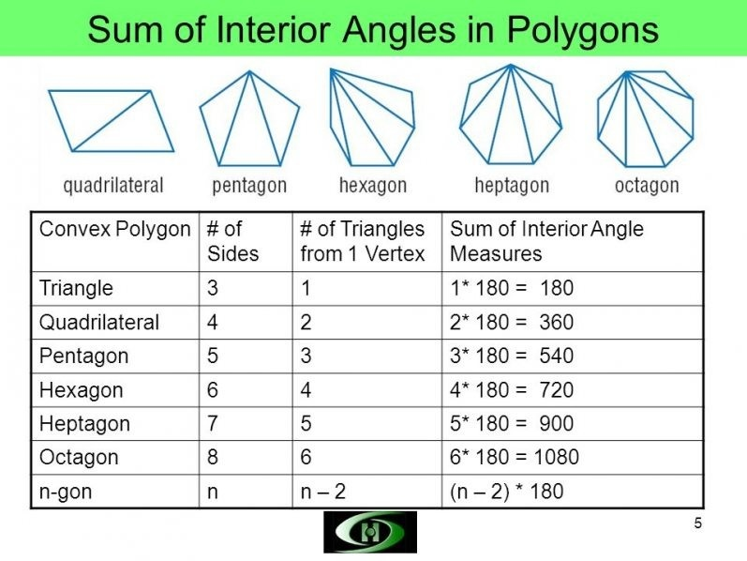
Sum of exterior angles = 360 / n
Number of diagonals = n(n-3) / 2

Slide 42
PROBLEM - 26
Each interior angle of a regular polygon is 120 degrees greater than each exterior angle. How many sides does the polygon have?

Slide 43
AREA
IMPORTANT FORMULAE
Area of a rectangle = (Length x Breadth).
Perimeter of a rectangle = 2(Length + Breadth).
Area of a square = (side)² = 1/2(diagonal)².
Area of a triangle = 1/2 x Base x Height.
Area of a triangle = sqrt of s(s-a)(s-b)(s-c) where a, b, c are the sides of the triangle and s = 1/2(a + b + c).
Area of an equilateral triangle rt.3/4 x (side)^{2.}

Slide 44
AREA
IMPORTANT FORMULAE
Radius of incircle of an equilateral triangle of side a =a / 2 rt3
Radius of circumcircle of an equilateral triangle of side a =a/ rt3
Area of parallelogram = (Base x Height).
Area of a rhombus = 1/2 x (Product of diagonals).
Area of a trapezium = 1/2 x (sum of parallel sides) x distance between them.
Area of a circle = πR², where R is the radius.
Circumference of a circle = 2 π R.
Circumference of a semi-circle = π R.
Area of semi-circle = π R²/2

Slide 45
AREA
1. The ratio between the perimeter and the breadth of a rectangle is 5 : 1. If the area of the rectangle is 216 sq. cm, what is the length of the rectangle?
A.16 cm B.18 cm
C. 24 cm D. Data inadequate
E. None of these
2. A rectangular park 60 m long and 40 m wide has two concrete crossroads running in the middle of the park and rest of the park has been used as a lawn. If the area of the lawn is 2109 sq. m, then what is the width of the road?
A.2.91 m B.3 m
C.5.82 m D. None of these

Slide 46
AREA
3. A man walked diagonally across a square lot. Approximately, what was the percent saved by not walking along the edges?
A.20 B.24
C.30 D.33
4. The length of a rectangular plot is 20 metres more than its breadth. If the cost of fencing the plot @ 26.50 per metre is Rs. 5300, what is the length of the plot in metres?
A.40 B.50
C.120 D. NOTA
5. The diagonal of a rectangle is √ 41 cm and its area is 20 sq. cm. The perimeter of the rectangle must be:
A.9 cm B.18 cm
C.20 cm D.41 cm

Slide 47
AREA
6. The diameter of a driving wheel of the bus is 1.4 m. How many revolutions per minute must the wheel make in order to keep a speed of 66 km/hour?
220 rpm B 240 rpm
C. 250 rpm D. 275 rpm
7. A man by walking diametrically across a circular grass plot finds that it has taken him 44 seconds less than if he had to walk around to reach the same destination. If his walking speed is 90 metres per minute, find the circumference of the plot.
320 m B. 363 m
C. 371.25 m D. 375.6 m

Slide 48
AREA
A cistern 6m long and 4 m wide contains water up to a depth of 1m and 25cm. The total area of the wet surface is
How many bricks each measuring 25cm x 12.5cm x 7.5cm
required to construct 6m x 5m x 0.5m?
10. A circular garden has a diameter of 56m. It has a circular path running all around and outside it. The difference between the circumferences of the larger and the smaller gardens is 44m. Find the width of the path?

Slide 49
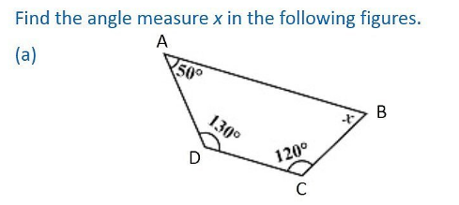
11.

Slide 50
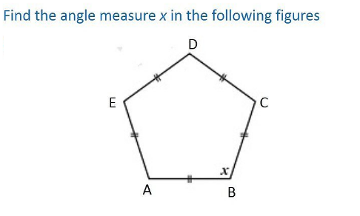
12.

Slide 51
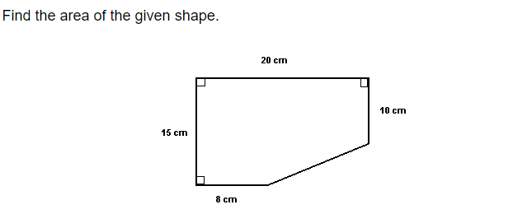
13.

Slide 52
VOLUME AND SURFACE AREA
CUBOID
Let length = l, breadth = b and height = h units. Then
Volume = (l x b x h) cubic units.
Surface area = 2(lb + bh + lh) sq. units.
Diagonal = ( l² + b² + h² ) ^1/2 units.
CUBE
Let each edge of a cube be of length a. Then,
Volume = a³ cubic units.
Surface area = 6a² sq. units.
Diagonal = sqrt of 3 x a units.

Slide 53
VOLUME AND SURFACE AREA
CYLINDER
Let radius of base = r and Height (or length) = h. Then,
Volume = ( πr²h) cubic units.
Curved surface area = (2 πrh) sq. units.
Total surface area = 2 πr(h + r) sq. units.
CONE
Let radius of base = r and Height = h. Then,
Slant height, l² = h² + r² units.
Volume = 1/3( π r²h) cubic units.
Curved surface area = (π rl) sq. units.
Total surface area = (π rl + π r²) sq. units.

Slide 54
VOLUME AND SURFACE AREA
SPHERE
Let the radius of the sphere be r. Then,
Volume = 4/3(π r³ )cubic units.
Surface area = (4 π r²) sq. units.
HEMISPHERE
Let the radius of a hemisphere be r. Then,
Volume = 2/3(π r³ )cubic units.
Curved surface area = (2 π r²) sq. units.
Total surface area = (3 π r²) sq. units.
Note: 1 litre = 1000 cm3.

Slide 55
VOLUME AND SURFACE AREA
1. A right triangle with sides 3 cm, 4 cm and 5 cm is rotated the side of 3 cm to form a cone. The volume of the cone so formed is:
A.12 π cm³
B.15 π cm³
C.16 π cm³
D.20 π cm³
2. In a shower, 5 cm of rain falls. The volume of water
that falls on 1.5 hectares of ground is:
A.75 cu. m
B.750 cu. m
C.7500 cu. m
D.75000 cu. m

Slide 56
VOLUME AND SURFACE AREA
3. A hall is 15 m long and 12 m broad. If the sum of the areas of the
floor and the ceiling is equal to the sum of the areas of four walls, the
volume of the hall is:
A.720
B.900
C.1200
D.1800
4. 66 cubic centimetres of silver is drawn into a wire 1 mm in
diameter. The length of the wire in metres will be:
A.84
B.90
C.168
D.336

Slide 57
VOLUME AND SURFACE AREA
5. A hollow iron pipe is 21 cm long and its external diameter is 8 cm.
If the thickness of the pipe is 1 cm and iron weighs 8 g/cm³, then the
weight of the pipe is:
A.3.6 kg
B.3.696 kg
C.36 kg
D.36.9 kg
6. A metallic sheet is of rectangular shape with dimensions 48 m x
36 m. From each of its corners, a square is cut off so as to make an
open box. If the length of the square is 8 m, the volume of the box
(in m³) is:
A.4830
B.5120
C.6420
D.8960

Slide 58
DOUBTS

Slide 59
THANK YOU
AND
BEST WISHES

